Slide 1
SOFTWARE RELIABILITY AND QUALITY MANAGEMENT

Slide 2
Software Reliability
Reliability of a software product essentially denotes its trustworthiness or dependability. Alternatively, reliability of a software product can also be defined as the probability of the product working “correctly” over a given period of time.

Slide 3
It is obvious that a software product having a large number of defects is unreliable. It is also clear that the reliability of a system improves, if the number of defects in it is reduced.
Thus, reliability of a product depends not only on the number of latent errors but also on the exact location of the errors.

Slide 4
Hardware vs Software Reliability
Reliability behaviour for hardware and software are very different.
For example, hardware failures are inherently different from software failures. Most hardware failures are due to component wear and tear or a resistor might short circuit. To fix hardware faults, one has to either replace or repair the failed part. On the other hand, a software product would continue to fail until the error is tracked down and either the design or the code is changed.

Slide 5
Change in failure rate(hardware)
For hardware products, it can be observed that failure rate is high initially but decreases as the faulty components are identified and removed. The system then enters its useful life. After some time (called product life time) the components wear out, and the failure rate increases. This gives the plot of hardware reliability over time its characteristics “bath tub” shape..

Slide 6
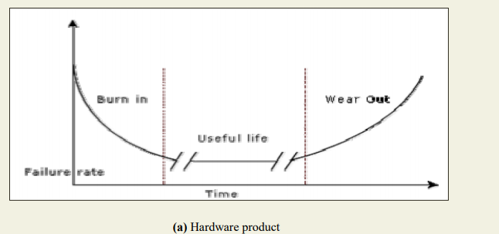

Slide 7
Change in failure rate(software)
On the other hand, for software the failure rate is at it’s highest during integration and test. As the system is tested, more and more errors are identified and removed resulting in reduced failure rate. This error removal continues at a slower pace during the useful life of the product. As the software becomes obsolete no error corrections occurs and the failure rate remains unchanged

Slide 8
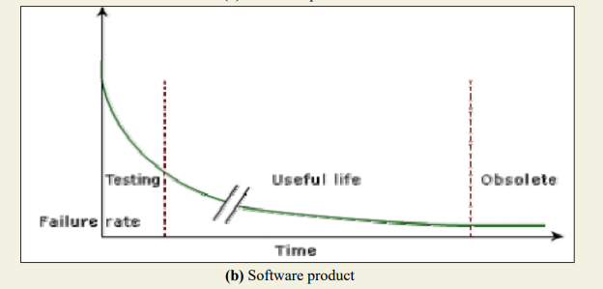

Slide 9
Reliability Metrics
There are six reliability metrics which can be used to quantify the reliability of software products.
Rate of occurrence of failure (ROCOF)- ROCOF measures the frequency of occurrence of unexpected behaviour (i.e. failures).
Eg 9/100

Slide 10

2. Mean Time To Failure (MTTF) - MTTF is the average time between two successive failures, observed over a large number of failures. To measure MTTF, we can record the failure data for n failures. Let the failures occur at the time instants t 1 , t 2 , …, t n . Then, MTTF can be calculated as

Slide 11
3. Mean Time To Repair (MTTR) - Once failure occurs, sometime is required to fix the error. MTTR measures the average time it takes to track the errors causing the failure and to fix them.
Mean Time Between Failure (MTBR) - MTTF and MTTR can be combined to get the MTBR metric:
MTBF = MTTF + MTTR.
Thus, MTBF of 300 hours indicates that once a failure occurs, the next failure is expected after 300 hours. In this case, time measurements are real time and not the execution time as in MTTF.

Slide 12
5. Probability of Failure on Demand (POFOD) - Unlike the other metrics discussed, this metric does not explicitly involve time measurements. POFOD measures the likelihood of the system failing when a service request is made. For example, a POFOD of 0.001 would mean that 1 out of every 1000 service requests would result in a failure.

Slide 13
6. Availability- Availability of a system is a measure of how likely shall the system be available for use over a given period of time
Availability=(MTBF/MTBF+MTTR)*100

Slide 14
Q what is the availability of software having Mean time between failure= 35days and mean time to repair= 7 hours?
Ans MTBF=35 days=35*24=840 hour
MTTR=7 hours
Availability=(MTBF/MTBF+MTTR)*100
Availability=(840/840+7)*100
=99.17%

Slide 15
SOFTWARE QUALITY
What is Quality?
Quality is meeting the requirement, expectation, and needs of the customer is free from the defects, lacks and substantial variants.

Slide 16
The modern view of a quality associates with a software product several quality factors such as the following:
Portability: A software product is said to be portable, if it can be easily made to work in different operating system environments, in different machines, with other software products, etc.
Usability: A software product has good usability, if different categories of users (i.e. both expert and novice users) can easily invoke the functions of the product.
Reusability: A software product has good reusability, if different modules of the product can easily be reused to develop new products.
Correctness: A software product is correct, if different requirements as specified in the SRS document have been correctly implemented.
Maintainability: A software product is maintainable, if errors can be easily corrected as and when they show up, new functions can be easily added to the product, and the functionalities of the product can be easily modified, etc.

Slide 17
What is Assurance?
Assurance is provided by organization management, it means giving a positive declaration on a product which obtains confidence for the outcome. It gives a security that the product will work without any glitches as per the expectations or requests.

Slide 18

What is Quality Assurance?
Quality Assurance is known as QA and focuses on preventing defect. Quality Assurance ensures that the approaches, techniques, methods and processes are designed for the projects are implemented correctly.
Quality Assurance has to complete before Quality Control

Slide 19
What is Control?
Control is to test or verify actual results by comparing it with the defined standards.

Slide 20
What is Quality Control?
Quality Control is known as QC and focuses on identifying a defect. QC ensures that the approaches, techniques, methods and processes are designed in the project are following correctly. QC activities monitor and verify that the project deliverables meet the defined quality standards.
It recognizes the defects. Quality Control has to complete after Quality Assurance.

Slide 21
What is The Difference in QA/QC?
Many people think QA and QC are the same and interchangeable but this is not true. Both are tightly linked and sometimes it is very difficult to identify the differences.
Fact is both are related to each other but they are different in origins. QA and QC both are part of Quality Management however QA is focusing on preventing defect while QC is focusing on identifying the defect.

Slide 22
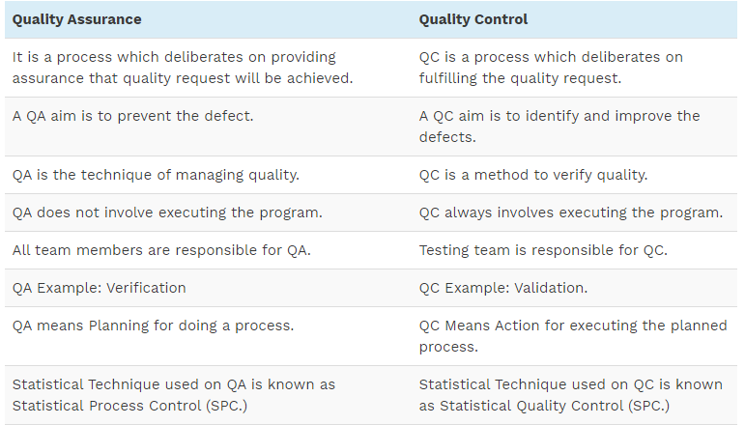
Here is the exact difference between Quality Control and Quality Assurance that one needs to know:

Slide 23
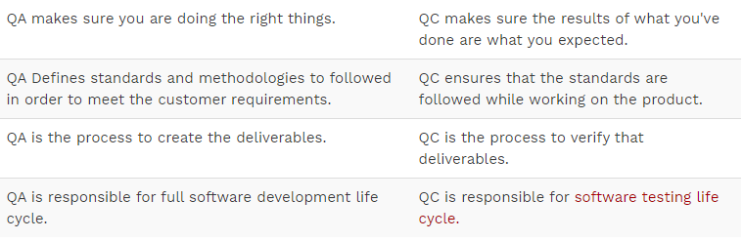

Slide 24
What is Software Quality Assurance?
Software quality assurance (SQA) is a process which assures that all software engineering processes, methods, activities and work items are monitored and comply against the defined standards. These defined standards could be one or a combination of any like ISO 9000, CMMI model, ISO15504, etc.

Slide 25
SQA Activities
1) Creating an SQA Management Plan:
The foremost activity includes laying down a proper plan regarding how the SQA will be carried out in your project.
2) Setting the Checkpoints:
The SQA team sets up different checkpoints according to which it evaluates the quality of the project activities at each checkpoint/project stage. This ensures regular quality inspection and working as per the schedule.

Slide 26
contd
3) Apply software Engineering Techniques:
Applying some software engineering techniques aids a software designer in achieving high-quality specification.
4) Executing Formal Technical Reviews:
An FTR is done to evaluate the quality and design of the prototype.
In this process, a meeting is conducted with the technical staff to discuss regarding the actual quality requirements of the software and the design quality of the prototype. This activity helps in detecting errors in the early phase of SDLC and reduces rework effort in the later phases.

Slide 27
contd
5) Having a Multi- Testing Strategy:
By multi-testing strategy, we mean that one should not rely on any single testing approach, instead, multiple types of testing should be performed so that the software product can be tested well from all angles to ensure better quality.

Slide 28
Quality Assurance Standards

Slide 29
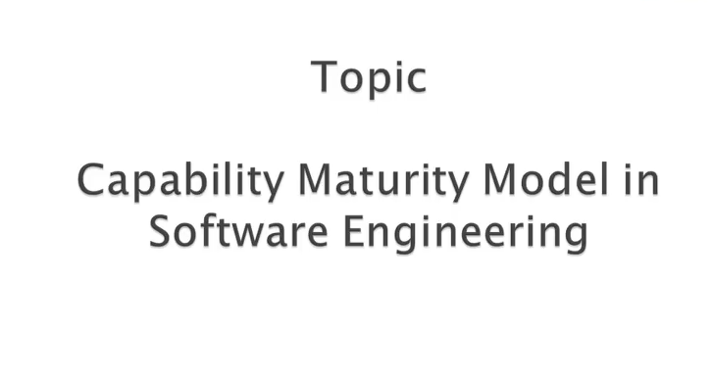
CMM MODEL

Slide 30
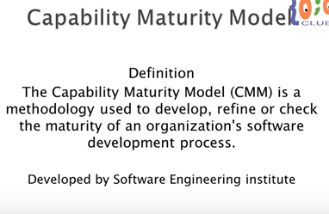

Slide 31
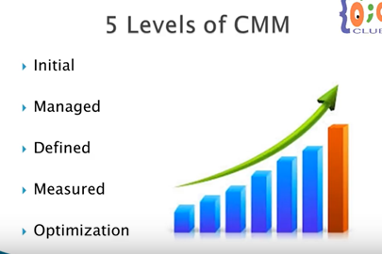

Slide 32
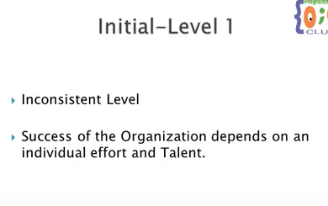

Slide 33
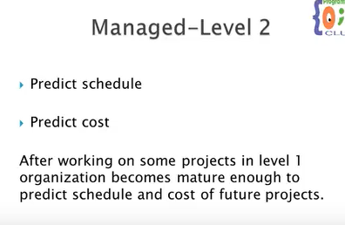

Slide 34
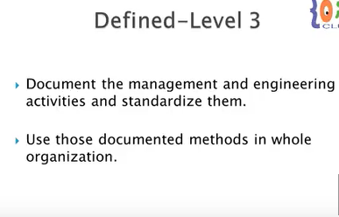

Slide 35
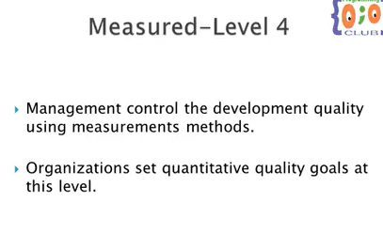

Slide 36
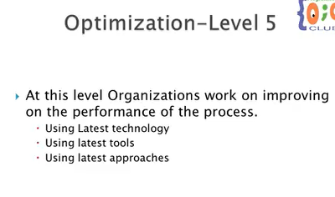

Slide 37
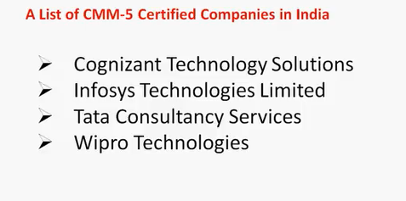

Slide 38
CMMI
CMMI (Capability maturity model integration) is the successor of capability maturity model.
In 2002, CMMI version 1.1 was released.
Version 1.2 followed in 2006.
CMMI aimed to improve the usability of maturity models by integrating many different models into one framework.

Slide 39
TOTAL QUALITY MANAGEMENT(TQM)

Slide 40
TOTAL
Involvement and input of everyone from top management to lower most employee of company

Slide 41
QUALITY
Fully meeting the customer needs and requirements all the time

Slide 42
MANAGEMENT
Art of planning, organizing, controlling etc.

Slide 43
Total Quality Management(TQM)
TQM is defined as a management technique for improving processes, products, services and the other approaches associated with the product.
TQM describes a management approaches to long-term success through customer satisfaction.

Slide 44
Companies that implement TQM
Ford Motor Company
Phillips Semiconductor
SGL Carbon
Toyota Motor Company

Slide 45
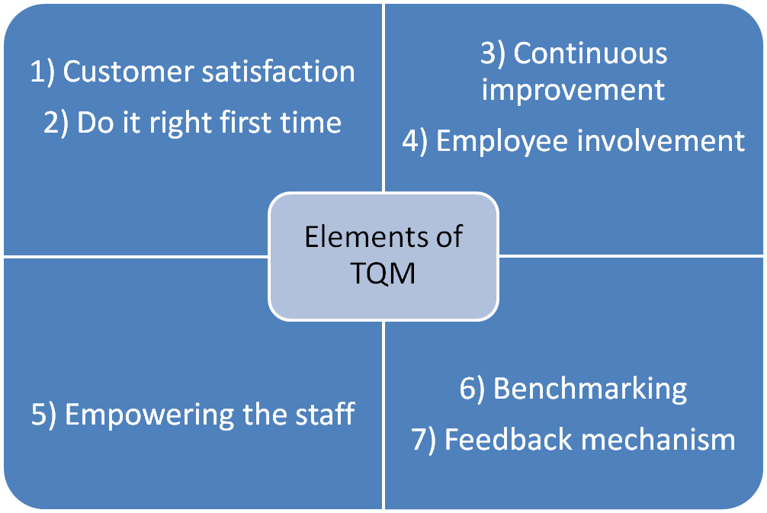

Slide 46
Benefits of TQM
It makes a company a leader not a follower.
TQM creates goal directed connection between customer, management, and workers. Everyone is contribute. Thus it fosters team work.
It makes the company more sensitive to customer needs.

Slide 47
Benefits of TQM to customers
Fewer problems with product or service
Better customer care
Greater satisfaction

Slide 48
Limitations of TQM
Time consuming and money consuming

Slide 49
ISO (International Organization for Standardization)

Slide 50
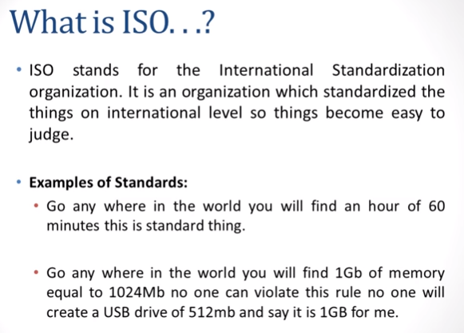

Slide 51
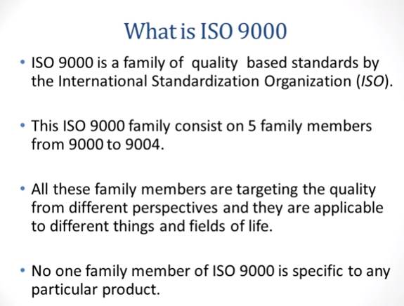

Slide 52
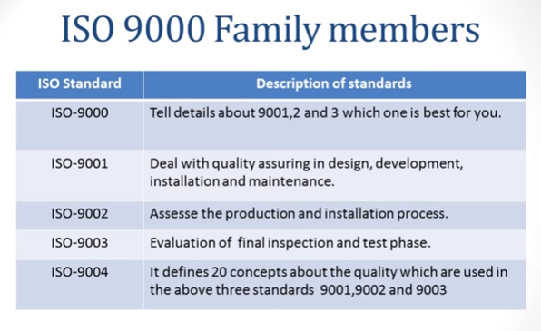


Slide 53
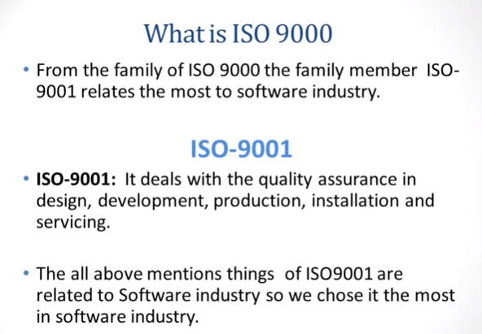

Slide 54
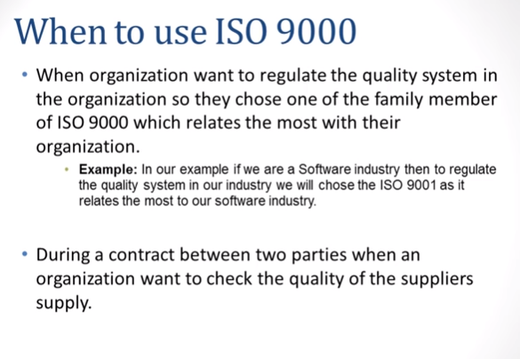

Slide 55
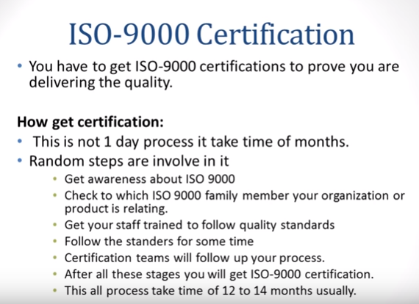

Slide 56
Application of ISO 9000 SERIES
ISO 9000- ALL INDUSTRIES INCLUDING SOFTWARE DEVELOPMENT.
ISO 9001-ENGINEERING AND CONSTRUCTION FIRMS,MANUFACTURERS THAT DESIGN,DEVELOP,INSTALL AND SERVICE PRODUCT
ISO 9002-COMPANIES IN THE CHEMICAL PROCESS INDUSTRIES THAT ARE NOT INVOLVED IN PRODUCT DESIGN OR AFTER SALES SERVICE.
ISO 9003-SMALL SHOP ,EQUIPMENT DISTRIBUTOR THAT INSPECT AND TEST SUPPLIED PRODUCT.
ISO 9004-ALL INDUSTRIES.

Slide 57
ISO 9001:2000
:2000:-This represent the year in which this version was updated so ISO 9001:2000 means 9001 was updated in year 2000.
ISO 9001:2000 specifies requirements for a quality management system where an organization
Needs to demonstrate its ability to consistently provide product that meets customer and applicable regularity requirements.
Aim to enhance customer satisfaction through the effective application of the system,including processes for continual improvement of the system.

Slide 58
Benefits of ISO 9001 Quality Management
Allows you to become a more consistent competetitor in your marketplace.
Better quality management helps you to meet customer needs.
More efficient ways of working will save time,money and resources.
Improved operational performance will cut errors and increase profit.

Slide 59
Six sigma

Slide 60
What is Six Sigma?
Six Sigma is a set of techniques and tools for process improvement. It seeks to improve the quality of the output of the process by identifying and removing the causes of defects and minimizing variability in manufacturing and business processes.

Slide 61
History Of Six Sigma
Bill Smith. And Bob Galvin,both of Motorola, developed the Six Sigma quality improvement process in 1986.The idea of Six Sigma is to improve quality so that the number of defects become so few that they are statistically.
Six Sigma has been in existence for a little over three decades now and has remained amongst one of the top most in demand skills.

Slide 62
Why we need Six Sigma for Software?
Software today is responsible for most of the added value in products, and must be blamed for many of its failures.
Software is so common these days that we must solve the software development problem to address a lot of other problems the society has.
The Six Sigma approach is:
Set the goal – Define
Define the metrics – Measure
Measure where you go – Analyse
Improve your processes while you go – Improve
Act immediately if going the wrong path – Control

Slide 63
Six Sigma states that defects can be eliminated by reducing variation.
Reducing variation means:
Improved Customer Specification.
Reduced Operating Costs.
Increased Profitability.

Slide 64
Six Sigma Methods
There are 2 methods of Six Sigma :
DMAIC: This is for process improvement by reducing process variation.
DMADV: This is for designing new processes and products.

Slide 65
DMAIC
A problem solving method that is a roadmap which can be used for any projects or quality improvements that needs to be made.

Slide 66
Why DMAIC?
This methodology should be used when a product or process is in existence at your company but is not meeting customer specification or is not performing adequately.

Slide 67
Phases of DMAIC
Define
Measure
Analyse
Improve
Control

Slide 68
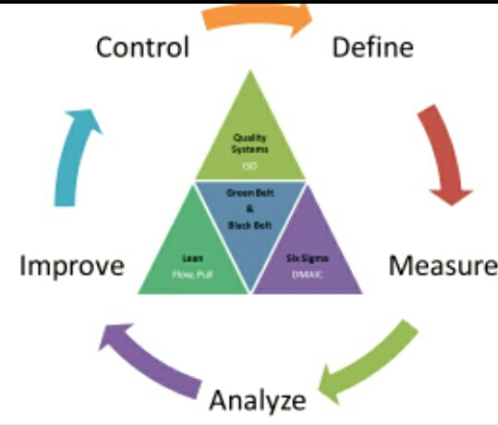

Slide 69
DEFINE- DEFINE THE PROBLEM
What problem would you like to fix?
Define the system, the voice of the customer and their requirements, and the project goals.

Slide 70
MEASURE- MAP OUT THE CURRENT PROBLEM
How does the process currently perform?
Measure key aspects of the current process and collect relevant data.

Slide 71
ANALYSE- IDENTIFY THE CAUSE OF THE PROBLEM
Analyse the data to investigate and cause and effect relationships . Determine what the relationships are, and attempt to ensure that all factors have been considered. It helps to seek out the root cause of the defect under investigation.

Slide 72
IMPROVE- IMPLEMENT AND VERIFY THE SOLUTION
How will the team mitigate the root causes of the problem?
Improve or optimize the current process based upon data analysis using techniques such as design of experiments , mistake proofing, and standard work to create a new ,future state process.

Slide 73
CONTROL-MAINTAIN THE SOLUTION
Ensure the process is properly managed and monitored
In the Control phase, the team begins to document exactly how they want to sustain improvements by passing process improvement infrastructure on to the employees who work within the process.

Slide 74
DMADV
It is also known as DSS(Design for six sigma).
It is used to design new processes or products to the client correctly.

Slide 75
Phases of DMADV
D-Define
M-Measure
A-Analyze
D-Design
V-Verify

Slide 76
Define
Define design goals that are consistent with customer demands and the enterprise strategy.

Slide 77
Measure
Measure product capabilities, production process capability, and risks.

Slide 78
Analyze
Analyze to develop and design alternate designs.

Slide 79
Design
Design an improved alternative, best suited per analysis in the previous step.

Slide 80
Verify
Verify the design , set up pilot runs,implement the production process and hand it over to the process owners.

Slide 81
DMAIC vs DMADV
DEFINE
MEASURE
ANALYZE
IMPROVE
DESIGN
CONTROL
VALIDATE/VERIFY

